Slide 1



Neuroinformatics Journal Club Discussion
Led by Aaron S. Kemp, MBA – PhD Candidate, UAMS
08/05/22

Slide 2
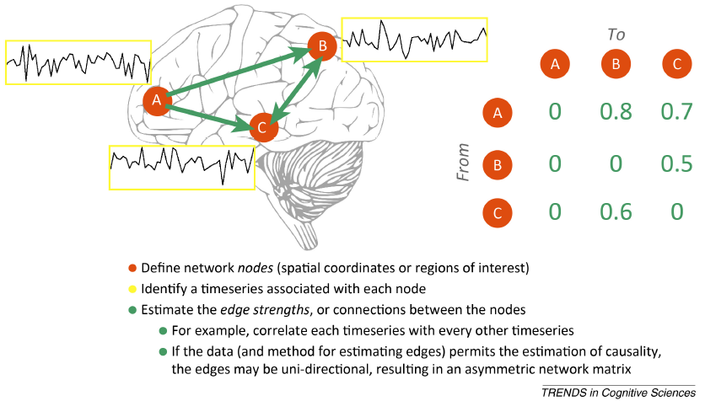
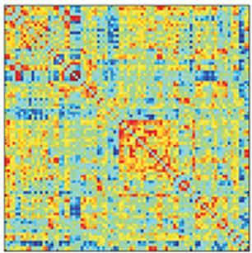
Smith, Stephen M., et al. "Functional connectomics from resting-state fMRI." Trends in cognitive sciences 17.12 (2013): 666-682.

Slide 3
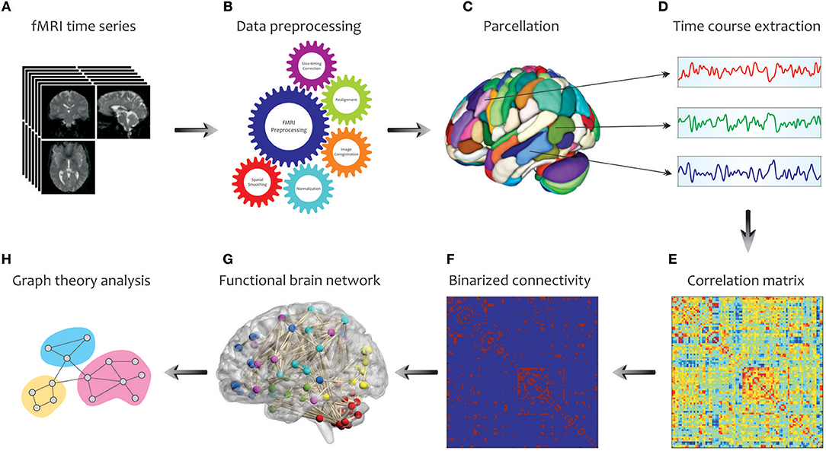
Farahani, Farzad V. (2019). "Application of Graph Theory for Identifying Connectivity Patterns in Human Brain Networks: A Systematic Review". Frontiers in neuroscience (1662-4548), 13 .

Slide 4
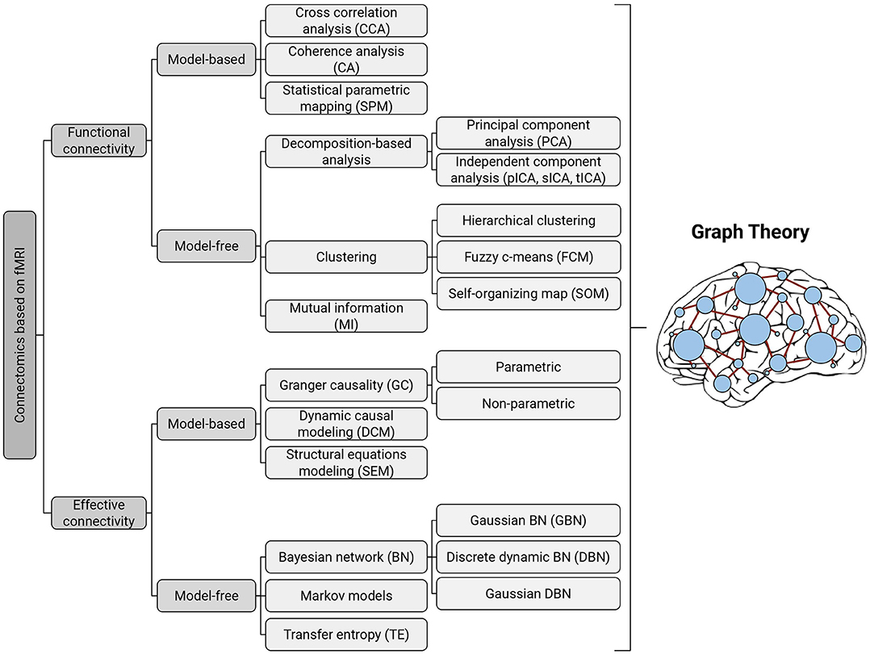
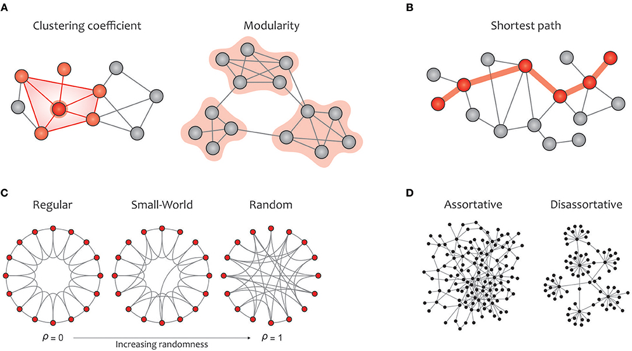
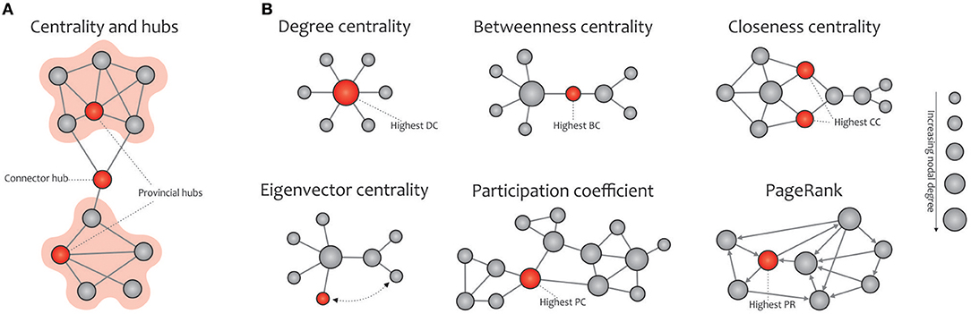
Farahani, Farzad V. (2019). "Application of Graph Theory for Identifying Connectivity Patterns in Human Brain Networks: A Systematic Review". Frontiers in neuroscience (1662-4548), 13 .
Notes:
Taxonomy of existing methods for modeling functional and effective connectivity patterns using fMRI. Each of the identified methods can be represented in terms of a graph, where the nodes correspond to cortical or subcortical regions and the edges represent (directed or undirected) connections (Bullmore and Sporns, 2012); thereby all of them can be further examined with graph-theoretic measures.

Slide 5
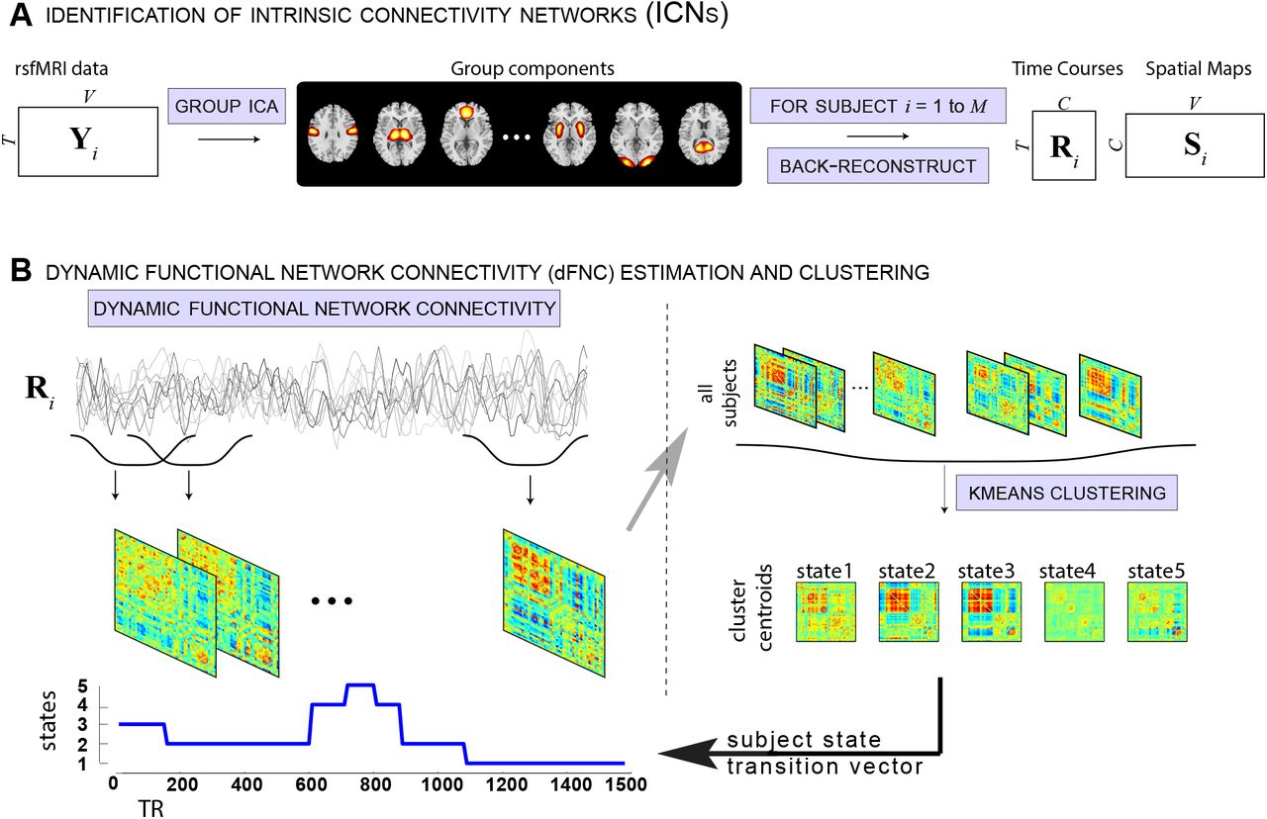
Calhoun, Vince D., et al. The chronnectome: time-varying connectivity networks as the next frontier in fMRI data discovery. Neuron 84.2 (2014): 262-274.

Slide 6

In traditional graph theoretic analyses of brain networks, functional connectivity (FC) between brain regions—measured as correlation or coherence—is interpreted as an indicator of inter-regional communication³.
Strong node FC is observed between two brain regions if they exhibit a high level of instantaneous co-fluctuation in their signals and reflects temporally correlated activity between brain regions.
Faskowitz and colleagues⁴ introduced a new metric they call edge FC (eFC) to capture a different aspect of inter-regional communication: the dynamics of edges themselves.
If two sets of edges or connections co-fluctuate in concert, they exhibit strong eFC in this new framework.
The added benefits of tracking eFC across the brain are that it permits analysis of how communication patterns evolve over time and can reveal whether similar patterns of communication are occurring across different parts of the brain simultaneously.

Slide 7
There were three main goals of the work aiming to introduce eFC to the network neuroscience community:
Develop a framework for analyzing eFC using three large, publicly available neuroimaging datasets, the Human Connectome Project, Midnight Scan Club and Healthy Brain Network, to establish feasibility and evaluate the stability of the metric.
Partition eFC networks to explore community structures derived from this novel metric.
Assess how eFC can be modulated during brain states characterized by changes in sensory input during passive viewing of movies.
Notes:
The novelty of the approach introduced by Faskowitz and colleagues is that it overcomes limitations of previous methods that assign brain regions to only one community.

Slide 8
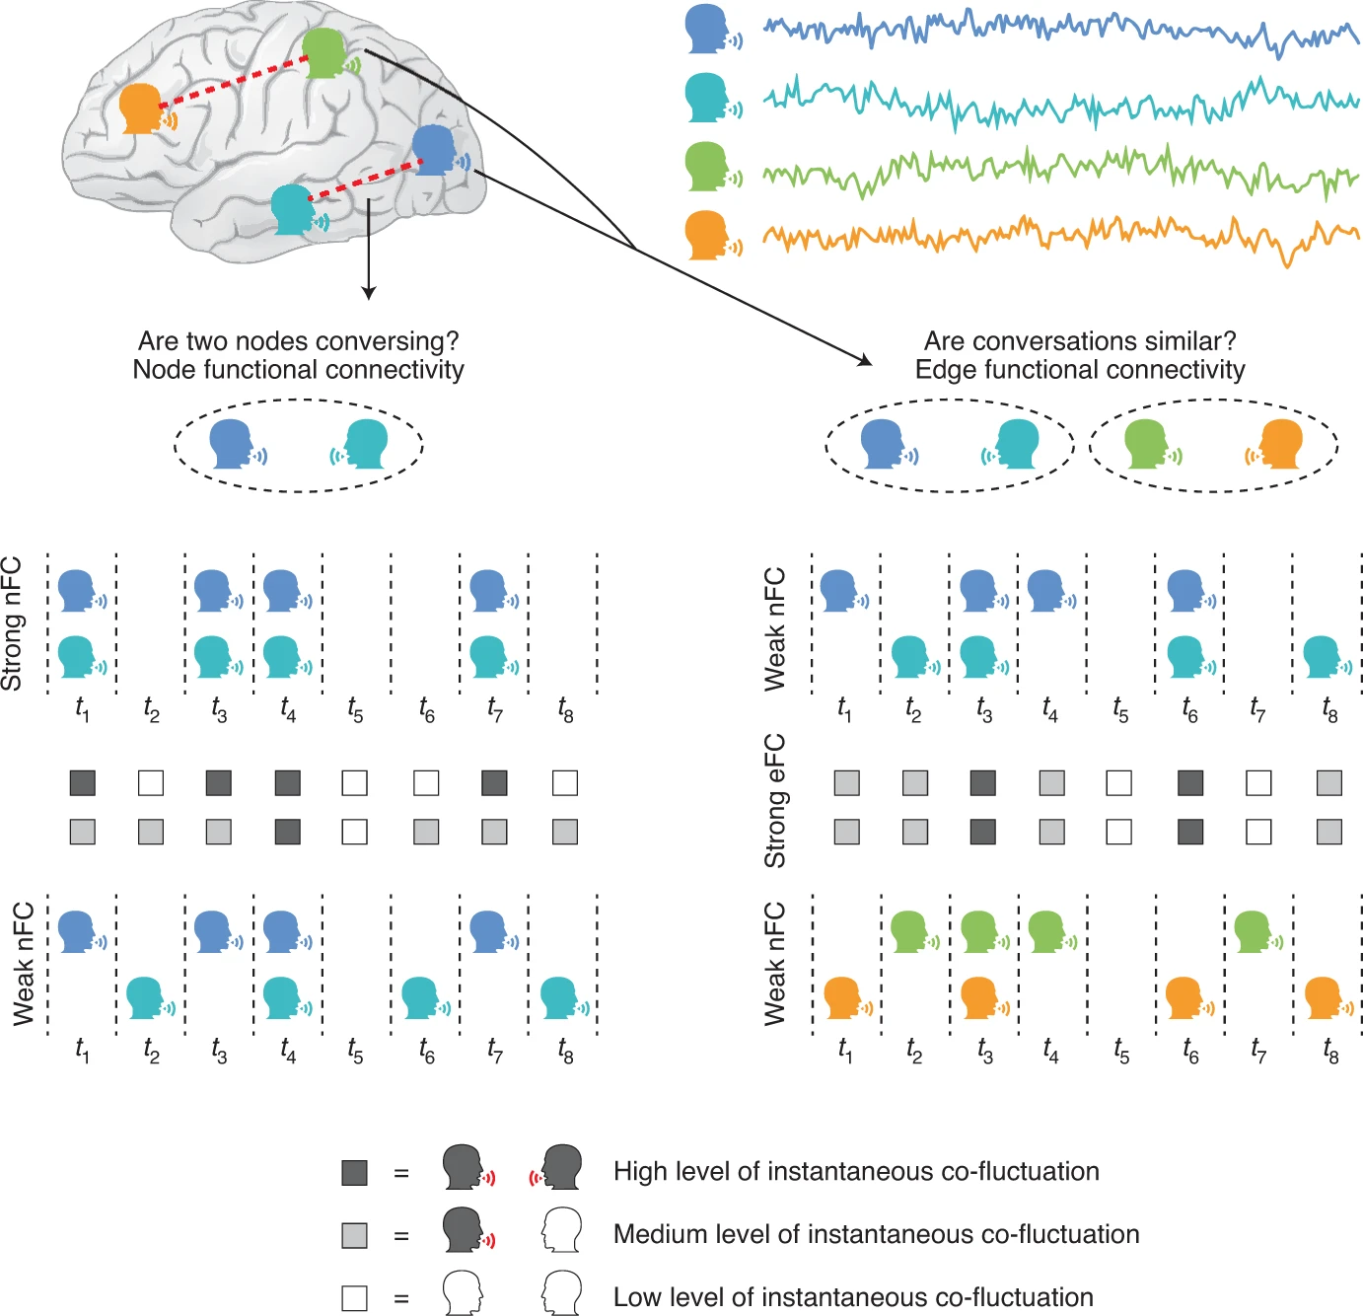
Notes:
New metrics for network neuroscience. Traditional approaches for measuring brain networks focus on characterizing properties of brain regions using node functional connectivity (nFC, left). The new edge-centric approach introduced by Faskowitz and colleagues estimates the extent to which dynamic interactions across connections of the brain share similar patterns using edge functional connectivity (eFC, right). These two metrics provide complementary information, emphasizing different features of brain networks. As shown in the bottom right, two sets of nodes that each exhibit weak nFC can nevertheless exhibit strong eFC if the edges connecting them instantaneously co-fluctuate.

Slide 9
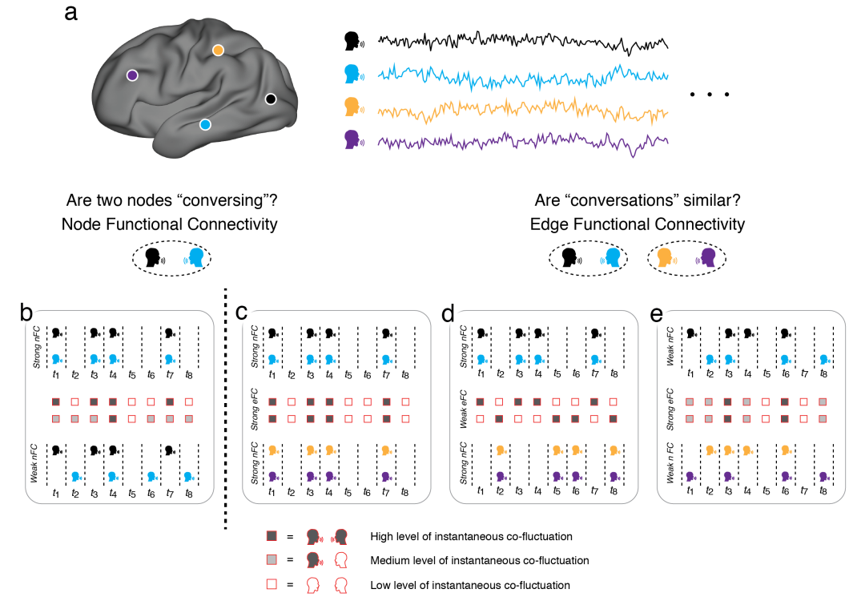
Notes:
Supplementary Figure 1. An intuitive schematic of edge functional connectivity. (a) Functional connectivity measures the statistical similarity of activity recorded from pairs of neural elements (nodes). (b) Strong functional connectivity reflects temporally correlated activity (top), which can informally be interpreted as a measure of communication or the strength with which nodes are conversing. Conversely, weak functional connectivity (bottom) reflects asynchronous activity, indicating the absence of communication. The edge-centric perspective, on the other hand, tracks the conversation between two nodes across time (the shading with red boxes indicate the instantaneous magnitude of conversation; darker and lighter colors indicate strong and weak communication, respectively). These time-varying estimates – which we refer to as “edge time series” – can be related to one another through the construct of edge functional connectivity. Whereas traditional node functional connectivity measures the extent to which two nodes converse with one another on average, edge functional connectivity focuses on the dynamics of their conversation and estimates the extent to which similar conversations are taking place in the brain simultaneously. Node and edge functional connectivity are complementary to one another and emphasize unique features of brain networks. Consider the examples shown in panels c-e. In c we show a case of two functionally connected pairs of nodes whose edge time series are also correlated (see red squares between the two time series). Strong node functional connectivity, however, does not imply strong edge connectivity. In panel d we show, again, two functionally connected nodes whose edge times series are exactly asynchronous and whose edge connectivity would be weak. Similarly, weak node functional connectivity does not imply weak edge connectivity. In panel e we show examples of weakly functionally connected nodes whose edge time series are nonetheless correlated with one another. We note that this schematic serves only to provide an intuitive description of eFC and its relationship with nFC. In reality, neural time series are signed and continuously-valued; their statistical dependences are more complicated than the idealized relationships depicted in panels b-e.

Slide 10
Overview
Network neuroscience has relied on a node-centric network model in which cells, populations and regions are linked to one another via anatomical or functional connections. This model cannot account for interactions of edges with one another.
This study introduces an edge-centric network model that generates constructs ‘edge time series’ and ‘edge functional connectivity’ (eFC).
Using network analysis, this study shows that, at rest, eFC is consistent across datasets and reproducible within the same individual over multiple scan sessions.
Clustering eFC yields communities of edges that naturally divide the brain into overlapping clusters, with regions in sensorimotor and attentional networks exhibiting the greatest levels of overlap.
Demonstrate that eFC is systematically modulated by variation in sensory input. In future work, the edge-centric approach could be useful for identifying novel biomarkers of disease, characterizing individual variation and mapping the architecture of highly resolved neural circuits.

Slide 11
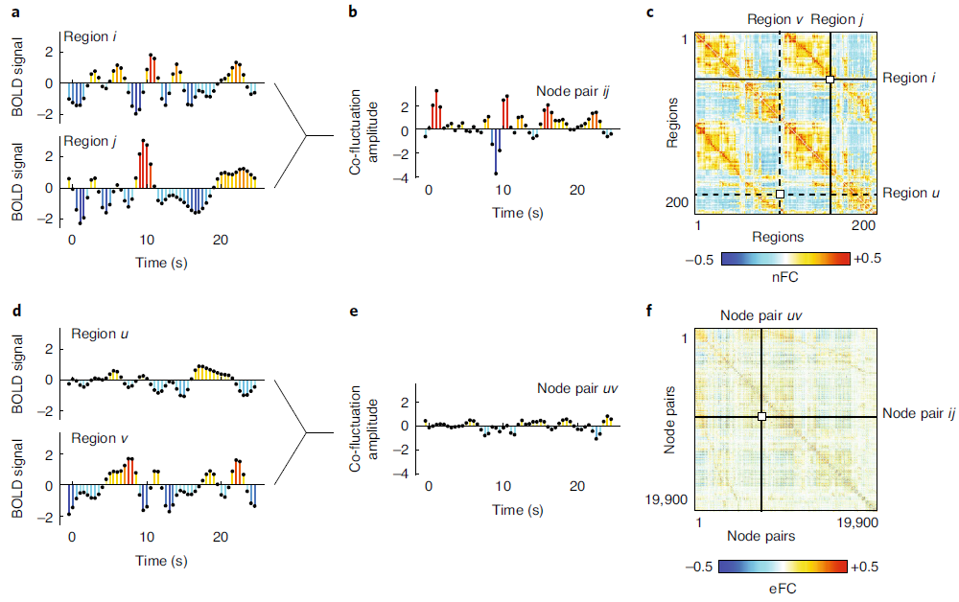
Notes:
Each element of the eFC matrix is calculated based on the fMRI BOLD activity time series from four nodes (brain regions). a,d, We show four representative times series from regions i, j, u and v. c, nFC is typically calculated by standardizing (z-scoring) each time series, performing an element-wise product (dot product) of time series pairs and calculating the average value of a product time series (actually the sum of each element divided by T − 1, where T is the number of observations). To calculate eFC, we retain the vectors of element-wise products for every pair of regions. b,e, We show product time series for the pairs {i,j} and {u,v}, respectively. The elements of these product time series represent the magnitude of time-resolved co-fluctuation between region pairs (or edges in the nFC graph). We can calculate the magnitude of eFC by performing an element-wise multiplication of the product time series and normalizing the sum by the squared root standard deviations of both time series, ensuring that the magnitude of eFC is bounded to the interval [−1,1]. f, The resulting value is stored in the eFC matrix.
calculating eFC can be accomplished in three steps,
Starting by z-scoring the time series (Fig. 1a,d).
Next, for all pairs of brain regions, we calculate the element-wise product of their z-scored time series (Fig. 1b,e).
This results in a new set of time series, referred to as ‘edge time series’, whose elements represent the instantaneous co-fluctuation magnitude between pairs of brain regions and whose average across time is exactly equal to the Pearson correlation coefficient (Fig. 1c)²⁰.
Co-fluctuation values are positive when activity of two regions deflects in the same direction at precisely the same moment in time, are negative when activity deflects in the opposite direction and are zero when activity is close to baseline.
Importantly, the magnitude of these edge time series is not systematically related to in-scanner motion (Supplementary Fig. 2). The third and final step involves calculating the element-wise product between pairs of edge time series. When repeated over all pairs of edges, the result is an edge-by-edge matrix whose elements are normalized to the interval [−1,1] (Figs. 1f and 2a; see Methods for additional details on eFC construction).

Slide 12
Stability of eFC across datasets
Notes:
Supplementary Figure 3. Comparison of group-averaged eFC across datasets. Here, we show two-dimensional
histograms comparing the similarity of group-averaged eFC matrices for each of the three datasets: Human Connectome
Project, Midnight Scan Club, and the Healthy Brain Network Serial Scanning Initiative. Point size and color are proportional
to probability (see key in gure).

Slide 13
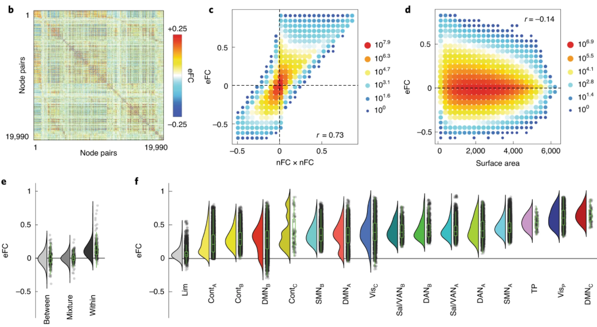
Notes:
b, eFC matrix in which rows and columns correspond to pairs of brain regions. c, Two-dimensional histogram of the relationship between eFC and the product of edges’ respective nFC weights. d, Two-dimensional histogram of the relationship between eFC and the surface area of the quadrilateral defined by the four nodes. e, Mean eFC among edges where both edges fall between systems (between; n = 2.3 × 10⁸), where one edge falls within and the other between systems (mixture; n = 1.7 × 10⁸) and where both edges fall within systems (within; n = 8.1 × 10⁵). f, Mean eFC among edges within 16 cognitive systems (n = 6.5 × 10⁴). All results presented in this figure are derived from HCP data. Box plots, shown in green and overlaid on data points in e and f, depict the interquartile range (IQR) and the median value of the distribution. Whiskers extend to the nearest points ±1.5× IQR above and below the 25th and 75th percentiles. Note that, in e, not all points can be displayed owing to the large number of edge–edge connections.
In general, we found that eFC was significantly stronger
for within-community edges compared to the other two categories
(Fig. 2e). Interestingly, we found that eFC could be distinguished
further by dividing within-community edges by cognitive system22
(one-way

Slide 14
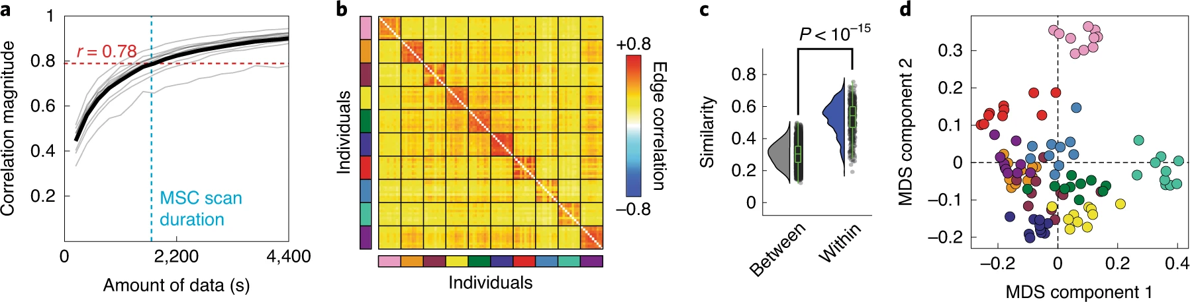
Notes:
a, Correlation of session-averaged eFC matrices with eFC estimated using different amounts of data; the mean value is shown as a black line. b, Similarity of eFC within and between participants. Each block corresponds to data from a single participant; participants are also identifiable by the color of the rectangle alongside each block. c, Violin plots of within- and between-participant similarity values from the matrix shown in b; n_{w} = 450 and n_{b} = 4,500 within- and between-participant comparisons (two-sample t-test; (4,948) = 62.98; P < 10⁻¹⁵). Box plots, shown in green and overlaid on data points in c, depict the IQR (box) and the median value of the distribution. Whiskers extend to the nearest points ±1.5× IQR above and below the 25th and 75th percentiles. d, Scan sessions plotted according to coordinates generated by performing a two-dimensional multidimensional scaling (MDS) analysis of the matrix in b. Note that scans from the same participant (shown here with the same color) are located near each other. All panels from this figure were generated using data from the MSC.
Collectively, these findings suggest that eFC exhibits a high level of participant specificity and captures idiosyncratic features of an individual, provided that eFC was estimated over a sufficiently long time period.
This observation serves as an important validation of eFC and suggests that eFC might be useful in future applications as substrate for biomarker generation and ‘fingerprinting’

Slide 15
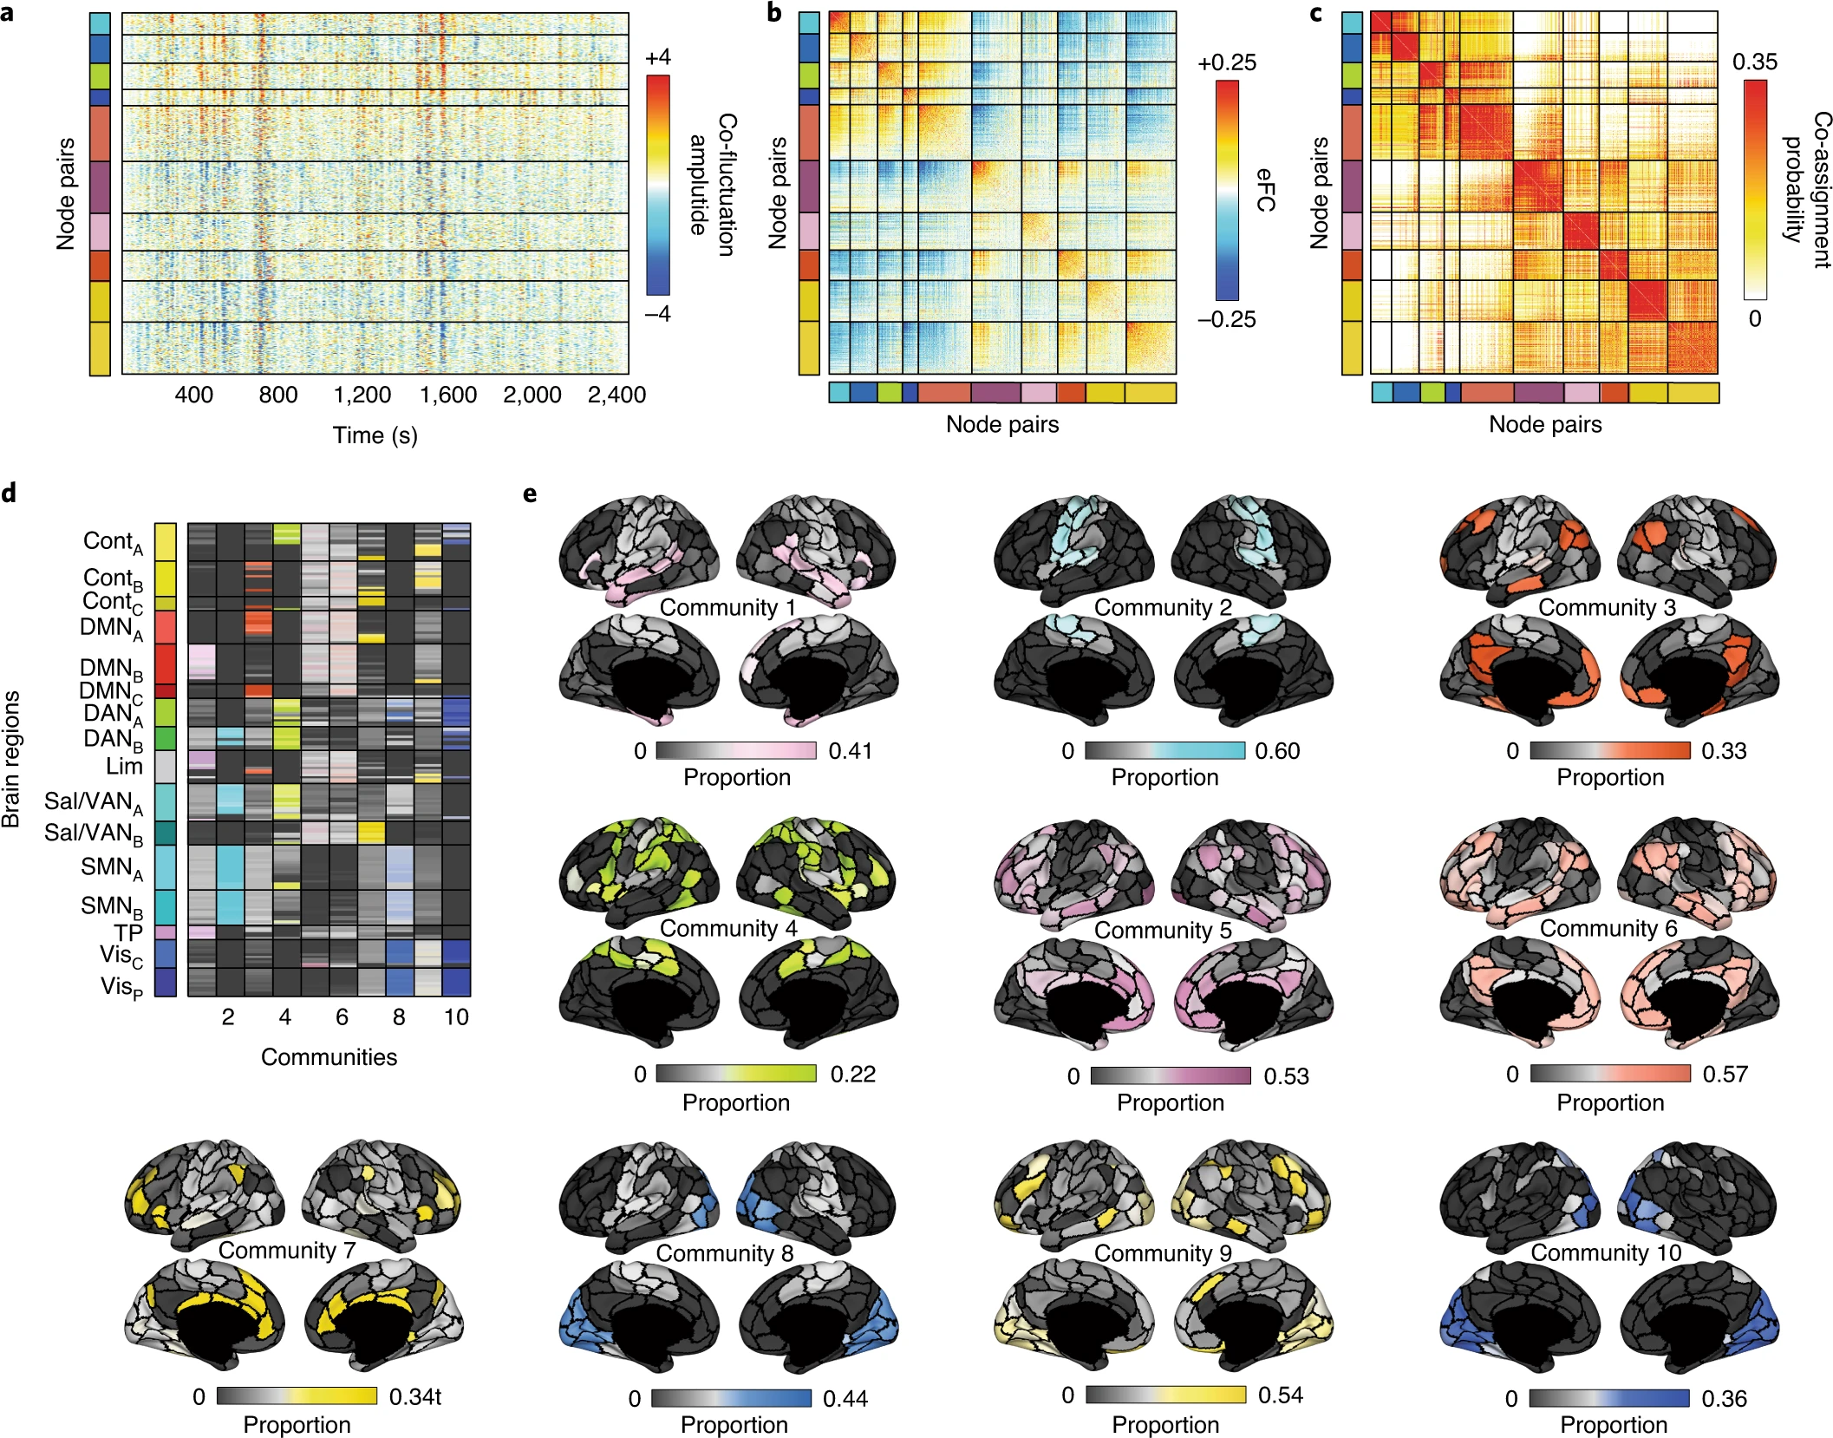
Notes:
We applied similarity-based k-means clustering to eFC from the HCP dataset. Here we show results with the number of clusters fixed at k = 10. a, Here we reordered edge time series according to the detected community assignments. Horizontal lines divide communities from each other. The colors to the left of the time series plots identify each of the ten communities. b, We also reordered the rows and columns of the eFC matrix to highlight the same ten communities. Note that, on average, within-community eFC is greater than between-community eFC. c, We calculated the probability that pairs of edges (node pairs) were co-assigned to the same community. Here we show the co-assignment matrix with rows and columns reordered according to community assignments. Note that, in general, the range of co-assignment probabilities goes to 1. Here we truncate the color limits to emphasize the ten-community partition (Supplementary Fig. 9 shows the same co-assignment matrix at different values of k and with non-truncated color limits). We present two visualizations of the edge communities projected back to brain regions (nodes). d, We depict overlapping communities in matrix form. Each column in this matrix represents one of ten communities. For each community and for each node, we calculated the proportion of all edges assigned to the community that included that node as one of its endpoints (‘stubs’), indicated by the color and brightness of each cell. Dark colors indicate few edges; bright colors indicate many. e, Topographic distribution of communities. Note that many of the communities resemble known intrinsic connectivity networks. However, because the communities here can overlap, it is possible for nodes associated with a particular intrinsic connectivity network to participate in multiple edge communities.
To demonstrate that the communities
capture meaningful variance in our data, we show the edge
co-fluctuation time series, the eFC matrix and the community
co-assignment matrix reordered according to the derived communities
(Fig. 4a–c). Here the elements of the co-assignment matrix
represent the probability that two edges were assigned to the same
community across partitions as we varied the number of communities
from k = 2 to k = 20.
Although the communities detected here are defined at the level
of edges rather than nodes, we can project edge communities back
onto brain regions. This was accomplished by extracting the edges
associated with each community, determining which nodes were at
the endpoints of each edge (the ‘stubs’) and counting the number of
times that each node was represented in this stub list. We show these
results in matrix form in Fig. 4d. In this panel, rows and columns
represent nodes ordered according to the canonical system labels
described in ref. 22.
The overlapping nature of communities is made clearer in
Fig. 4e, in which communities are represented topographically.
The edges associated with the same visual nodes are all involved
in communities 7, 8, 9 and 10 to some extent, thereby linking the
visual system to multiple other brain systems. In community 8, for
example, edges incident upon nodes in the visual and somatomotor
systems are clustered together, whereas, in community 9, edges
incident upon visual and control network nodes are assigned to the
same community.

Slide 16
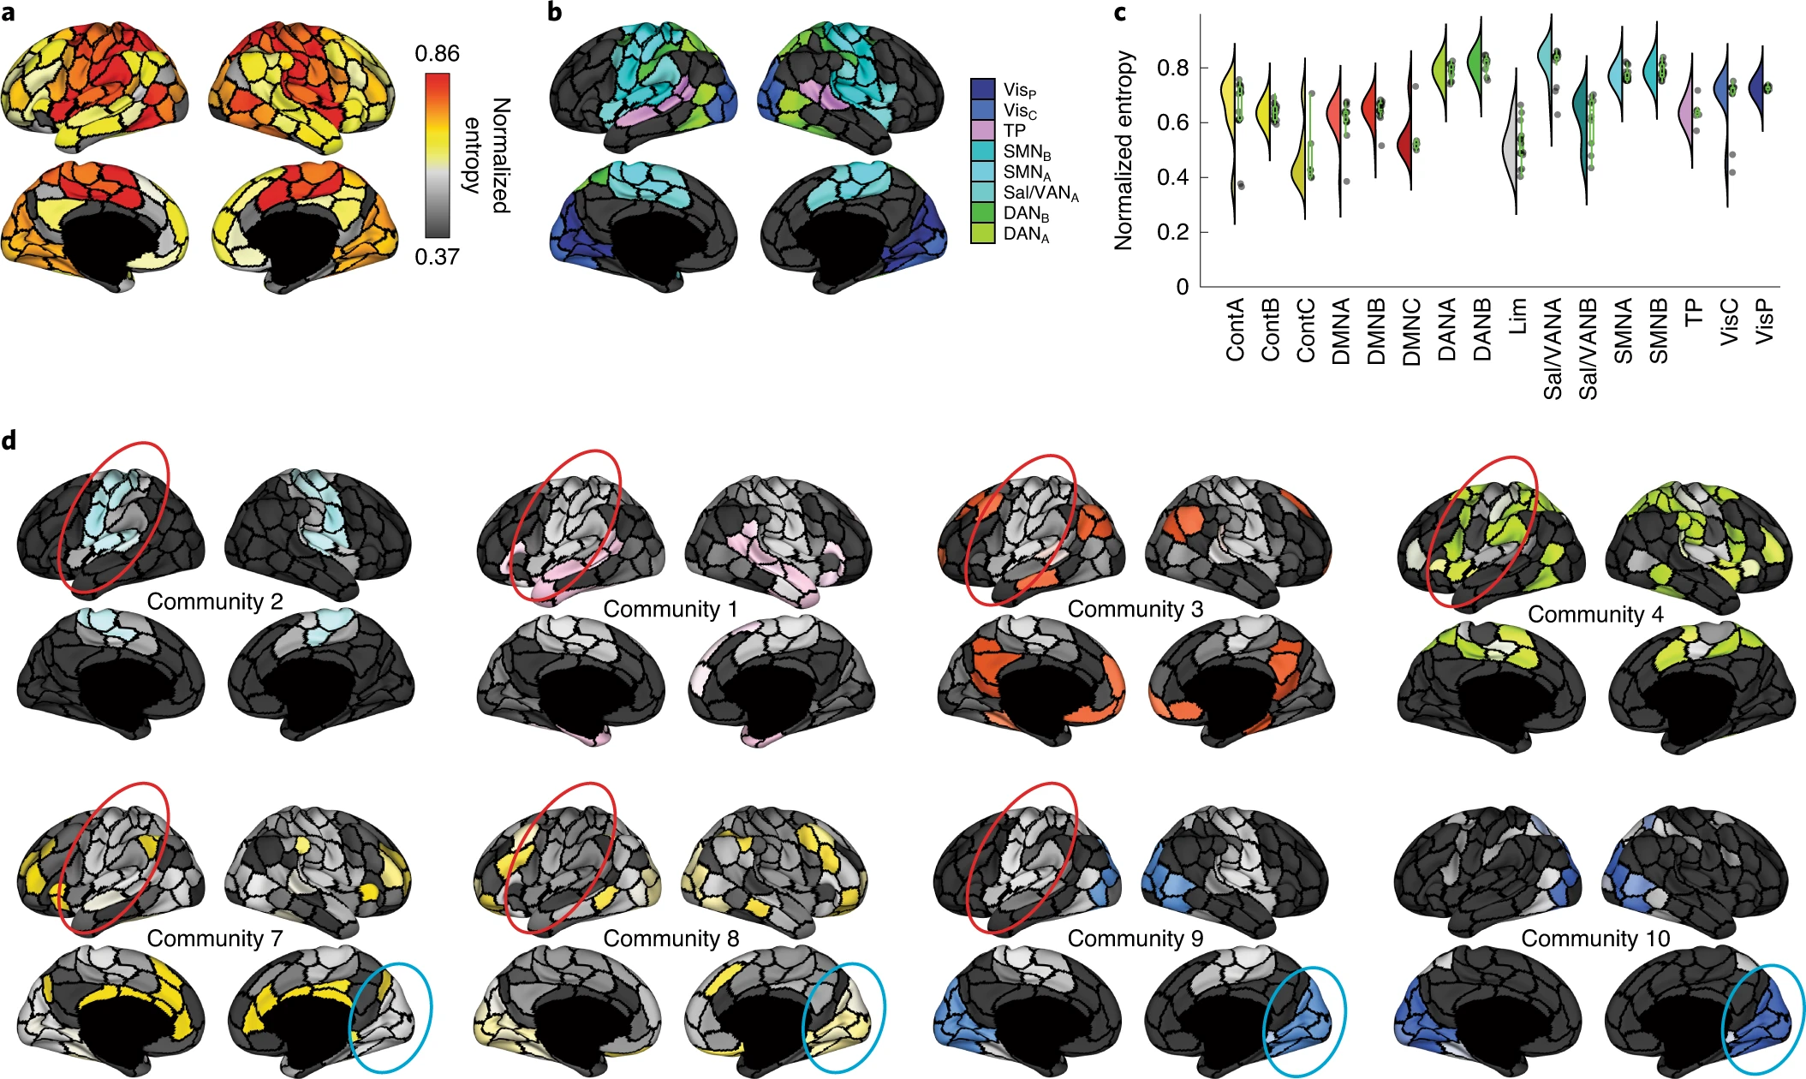
Notes:
a, Topographic distribution of normalized entropies. Normalized entropy, in this case, measures the uniformity of a node’s community assignments across all communities and serves as a measure of overlap. In general, higher entropy corresponds to greater levels of overlap. b, Brain systems associated with the highest levels of normalized entropy. These include visual, attentional, somatmotor and temporoparietal systems. c, Entropy values for all brain systems; n = 200 brain regions. Box plots, shown in green and overlaid on data points, depict the IQR (box) and the median value of the distribution. Whiskers extend to the nearest points ±1.5× IQR above and below the 25th and 75th percentiles. d, Here we highlight communities in which somatomotor (red) and visual (blue) systems are represented.
A more nuanced measure that accounts for the distribution
of edge community assignments is the normalized entropy,
which indexes the uniformity of a distribution. We therefore calculated
normalized entropy for every brain region while varying
the number of communities from k = 2 to k = 20. In this section, we
focus on results with k = 10.
We found that normalized community entropy was greatest
within sensorimotor and attentional systems and lowest within
regions traditionally associated with control and default mode networks
(Fig. 5a–c).
These observations seemingly contradict previous reports in which functional overlap
was greatest in control networks and lowest in primary sensory systems
(Fig. 5d)

Slide 17
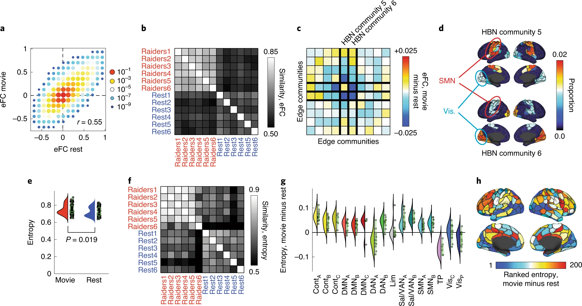
Notes:
a, Two-dimensional histogram of eFC estimated at rest with eFC estimated during movie watching. b, Similarity of whole-brain eFC estimated at rest with movie watching. Note that within-condition similarity is greater for both conditions. c, Community-averaged differences in eFC. Communities 5 and 6 are associated with the largest magnitude differences, on average. Note that these are communities estimated from HBN data and are not identical to those shown in Fig. 4, which were estimated from HCP data. d, Topographic distribution of communities 5 and 6. Note that these communities involve edges associated with visual and somatomotor systems. e, Averaged differences in community overlap (normalized entropy); n = 200 brain regions whose entropy scores were compared across rest and movie-watching conditions (permutation test; mean difference in paired samples; P = 0.019). f, Similarity of whole-brain normalized entropy estimated at rest with movie watching. g, Violin plot showing system-specific differences in normalized entropy. Note that some of the greatest increases in entropy are concentrated with control and default mode networks; n = 200 brain regions. h, Topographic distribution of differences in entropy. Box plots, shown in green and overlaid on data points in e and g, depict the IQR (box) and the median value of the distribution. Whiskers extend to the nearest points ±1.5× IQR above and below the 25th and 75th percentiles.

Slide 18
Key Results (selected quotes from article)
“Here we presented a network model of human cerebral cortex that focused on edge–edge interactions.
The network formed by these interactions—a construct we referred to as eFC—was similar across datasets and more similar within individuals than between them.
When clustered, eFC provided a natural estimate of pervasively overlapping community structure.
We found that the amount of overlap varied across the cortex but peaked in sensorimotor and attention networks.
We found that brain regions associated with sensorimotor and attention networks participated in disproportionately many communities compared to other brain systems, but that, relative to one another, those same regions participated in similar sets of communities.
Lastly, we showed that eFC and community overlap varied systematically during passive viewing of movies.”

Slide 19
Conclusions (quotes from article)
“In this study, we developed a novel edge-centric representation of functional neuroimaging data that operates directly on observed time series.
Our method for estimating connection weights between edges can be viewed as a temporal ‘unwrapping’ of the familiar Pearson correlation—the measure frequently used to estimate the magnitude of nFC between pairs of brain regions.
Whereas the Pearson correlation coefficient calculates the time-averaged co-fluctuation magnitude for node pairs, we simply omit the averaging step, yielding ‘edge time series’, which represent the co-fluctuation magnitude between two nodes at every instant in time.
This simple step enables us to track fluctuations in edge weight across time and, critically, allow for dyadic relationships between edges, creating an edge-centric representation of nervous system architecture.
If we interpret edge time series as a temporal unwrapping of nFC, which is thought to reflect the aggregate effect of communication processes between neural elements, then edge times series track, with high temporal resolution, the communication patterns between distributed neural elements.”

Slide 20
Future Directions
eFC might be useful in applications of machine learning and classification of neuroimaging data
Essentially, eFC time series offer a moment-to-moment assessment of how strongly two nodes (brain regions) co-fluctuate with one another, providing an estimate of time-varying nFC without the requirement that we specify a window.
This overcomes one of the main limitations of sliding window estimates of time-varying nFC, namely that the use of a window leads to a ‘blurring’ of events across time

Slide 22
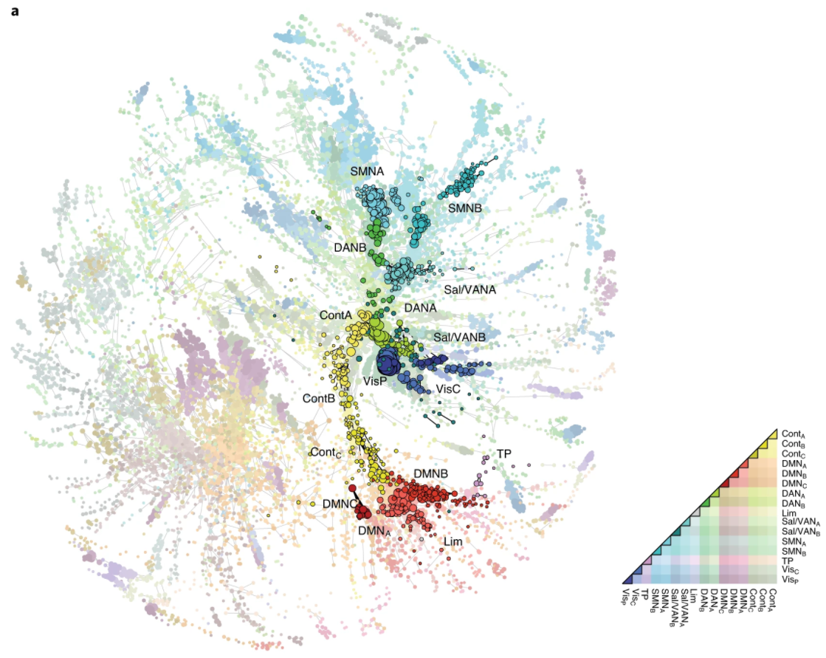
Notes:
a, Force-directed layout of the eFC matrix (largest connected component after thresholding away weak connections). Nodes in this graph represent edges in the traditional nFC matrix. Here nodes are colored according to whether the corresponding edge fell within or between cognitive systems. Within-system edges are encircled in black.

Slide 23
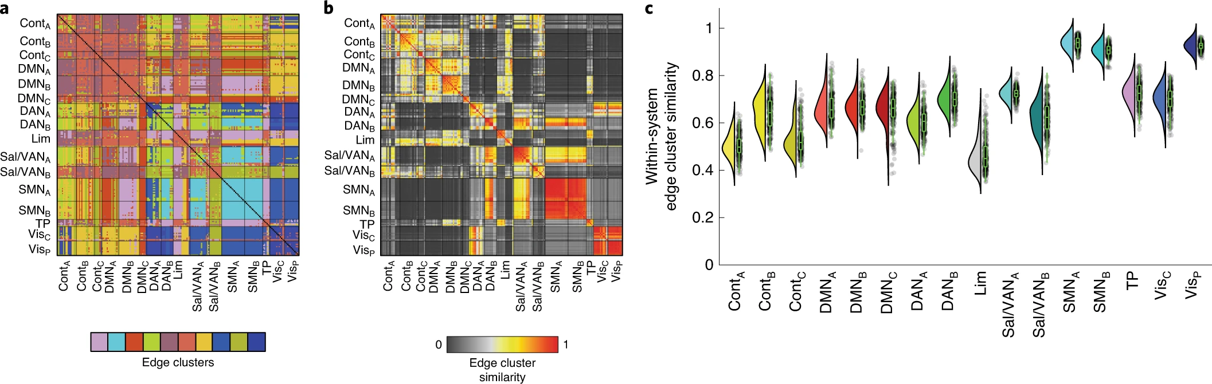
Notes:
a, Edge communities can be mapped into a [N × N] matrix. The element at row i and column j of the edge community matrix denotes the community label of edge {i,j}. b, We can then calculate the similarity of edge communities involving nodes i and j by comparing the values of columns i and j. This matrix depicts the similarity for all pairs of nodes. c, Within-system similarity values for each of the 16 pre-defined brain systems; n = 1,272 within-system similarity values. Box plots, shown in green and overlaid on data points, depict the IQR (box) and the median value of the distribution. Whiskers extend to the nearest points ±1.5× IQR above and below the 25th and 75th percentiles.

